Slide 1
Sample-Superstore storytelling
File created on: 3/31/2022 2:49:22 AM

Slide 2
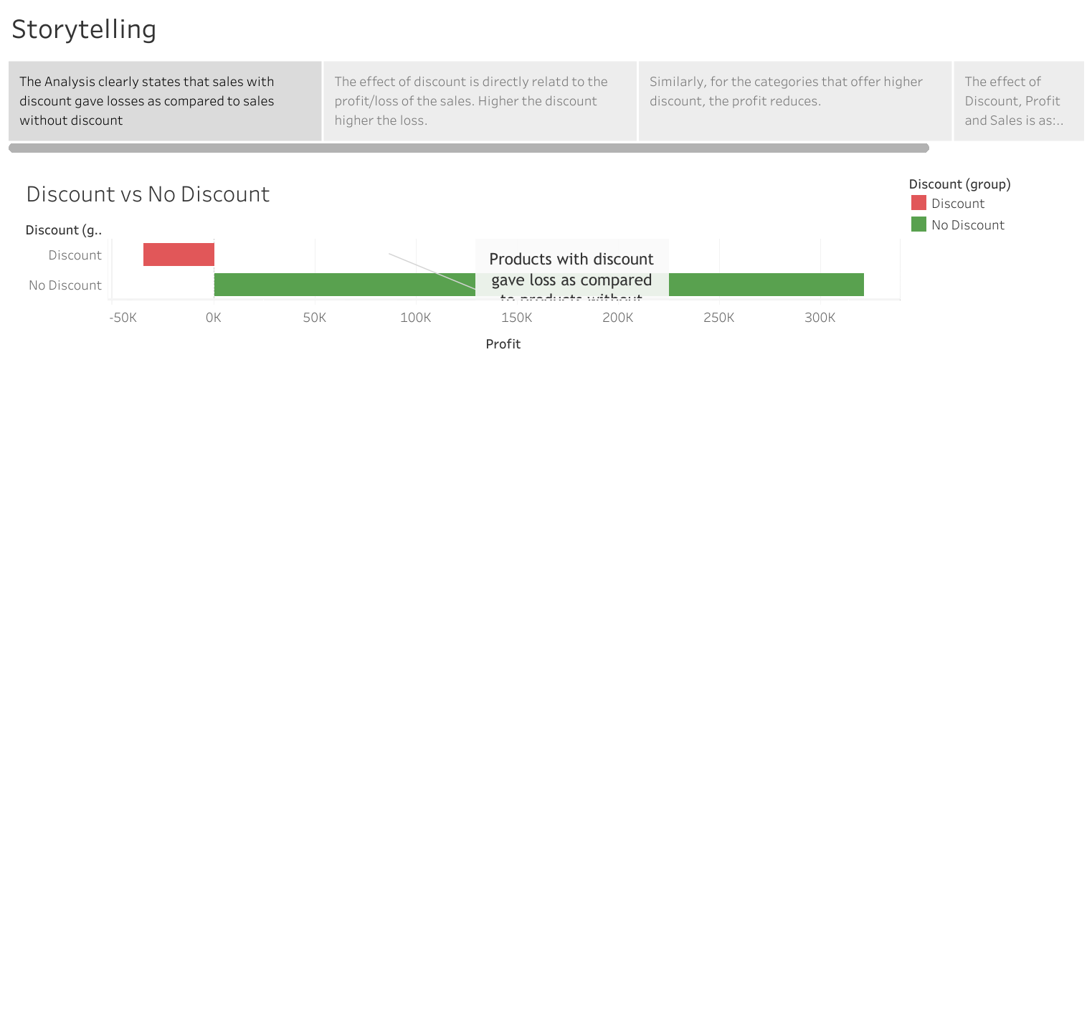

Slide 3
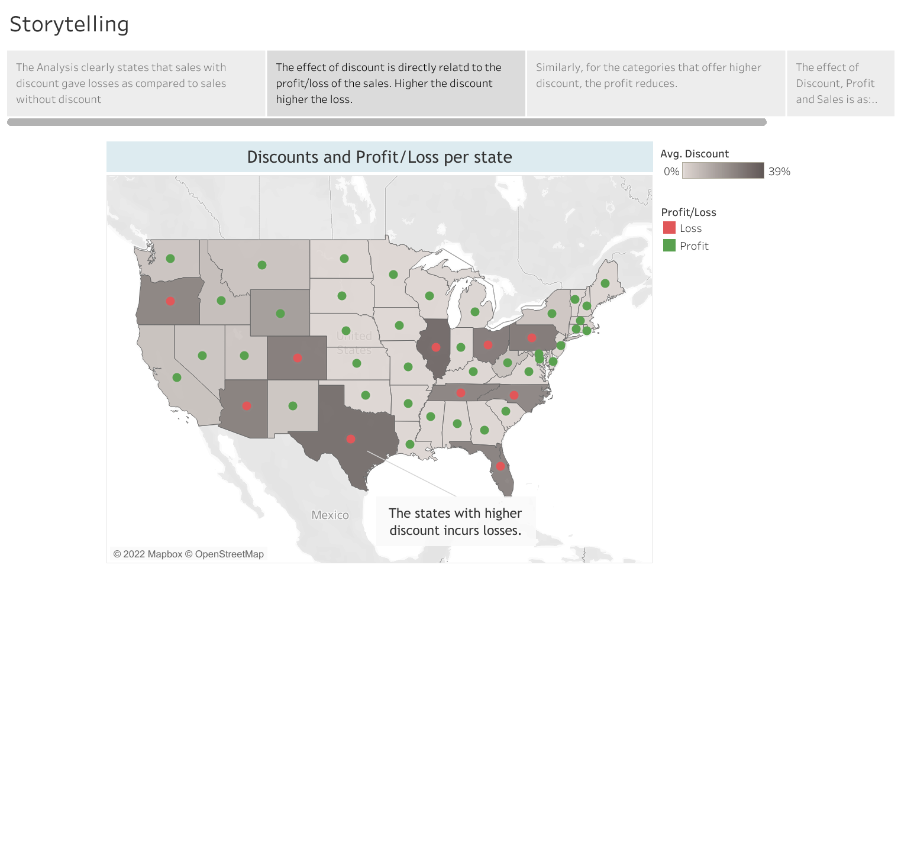

Slide 4
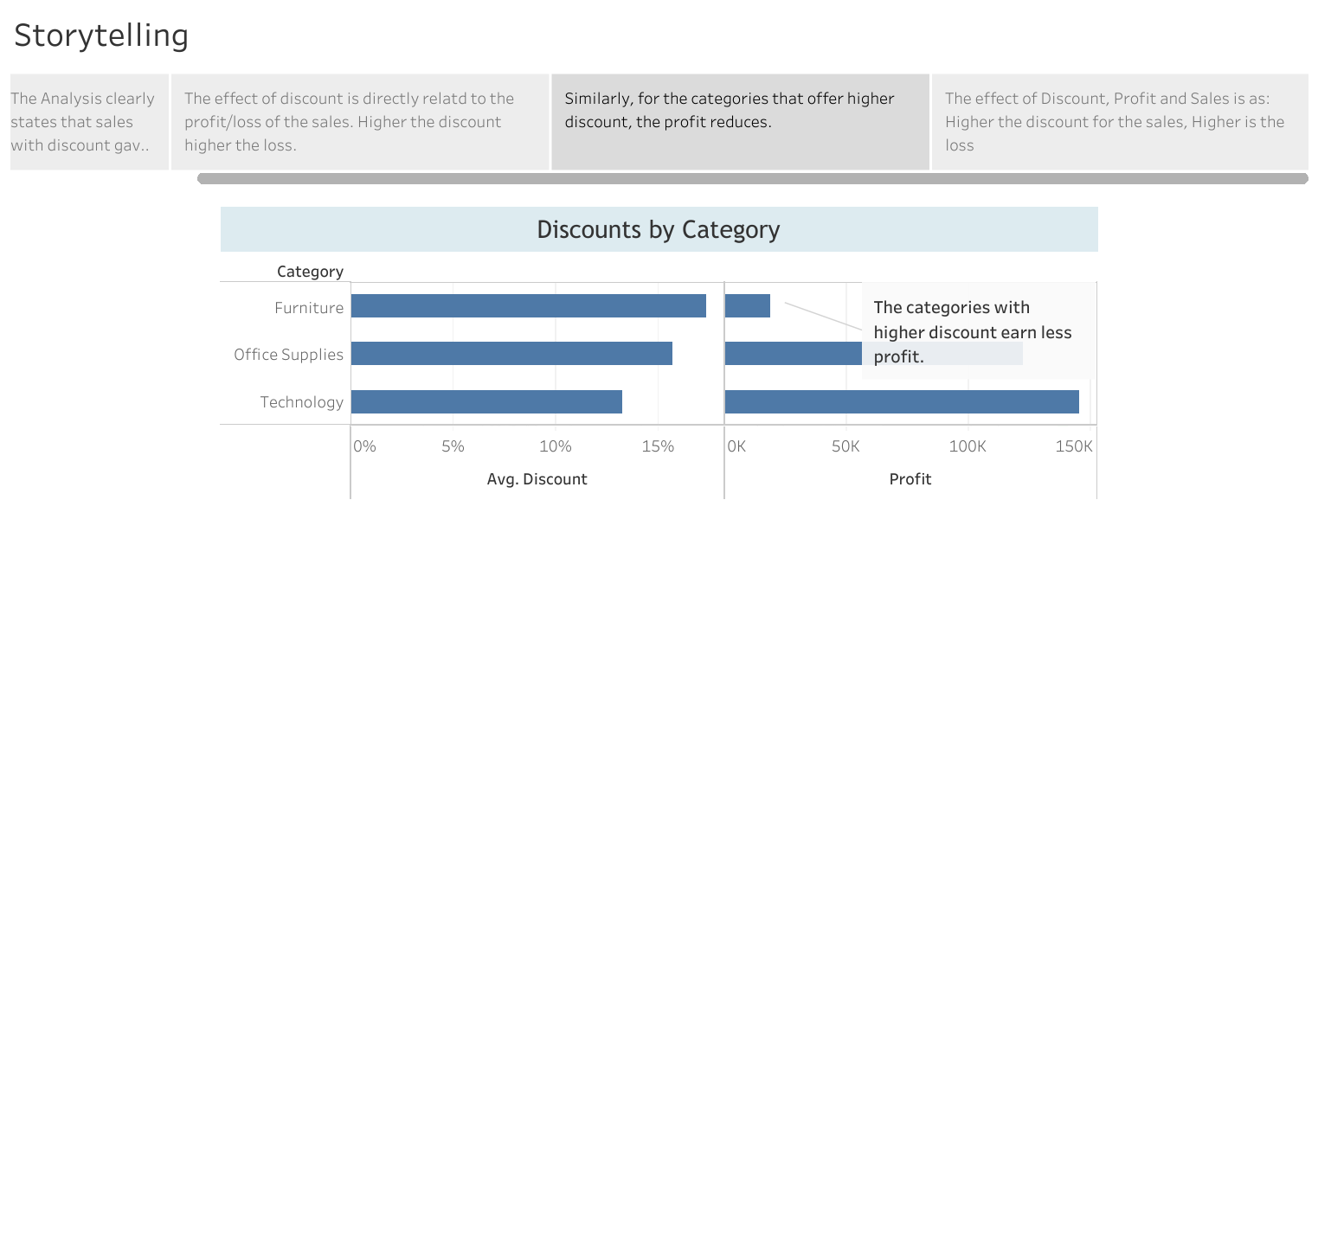

Slide 5
